Slide 1
~1 year, ~∞* possibilities
Elliot’s 2nd project!
*±∞

Slide 2

Overarching goals:
Grant applications
Pick some paths on the career skill tree
Time management
Research synthesis
Project management
Remote sensing expertise
Evolutionary biology expertise
Science communication and outreach
Data management
Conservation ecology expertise
Policy proposals
Scientific writing
Fieldwork
Teaching
Supervision
Working with collection specimens
Being a good person

Slide 3
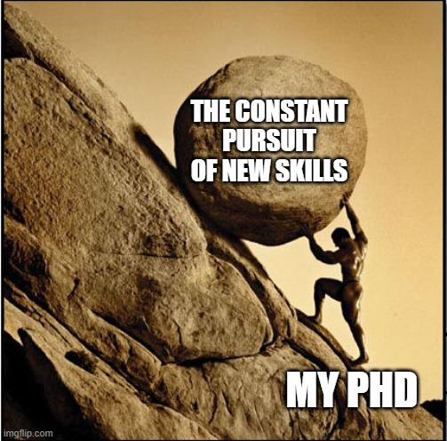
Gaining XP
Which skills to focus on?
How to attain them
Skills which align with my career goals
Skills which align with my strengths
Development of a framework to track XP and skill progression

Slide 4
Immediate goal:
Publishing a 2nd paper… But on what?

Slide 5
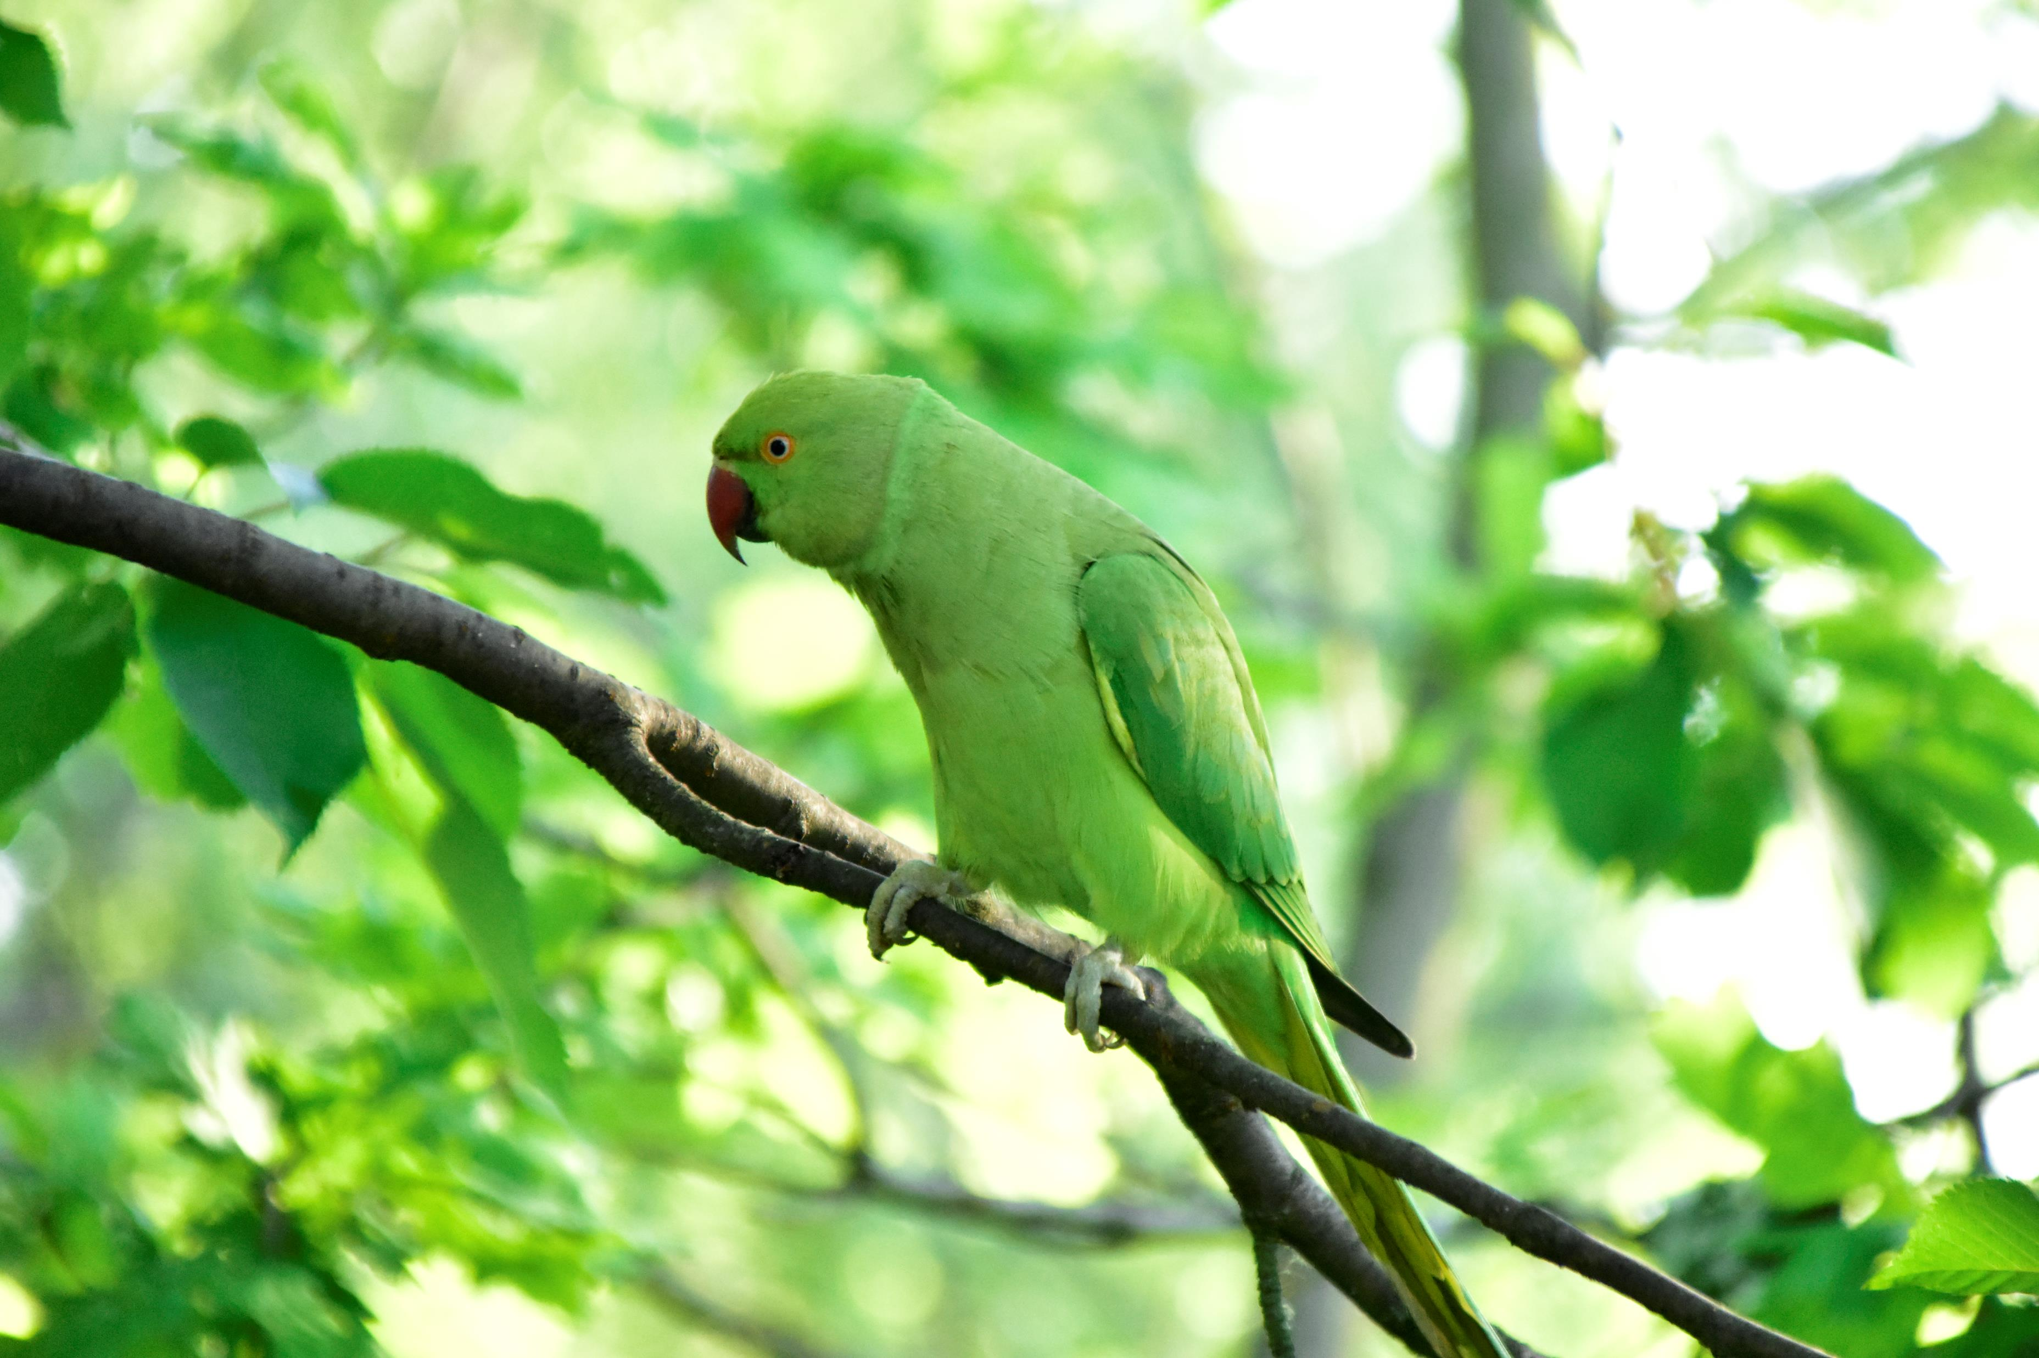
Hybridisation of the UK’s feral parakeets
Elliot’s favourite invasive species

Slide 6
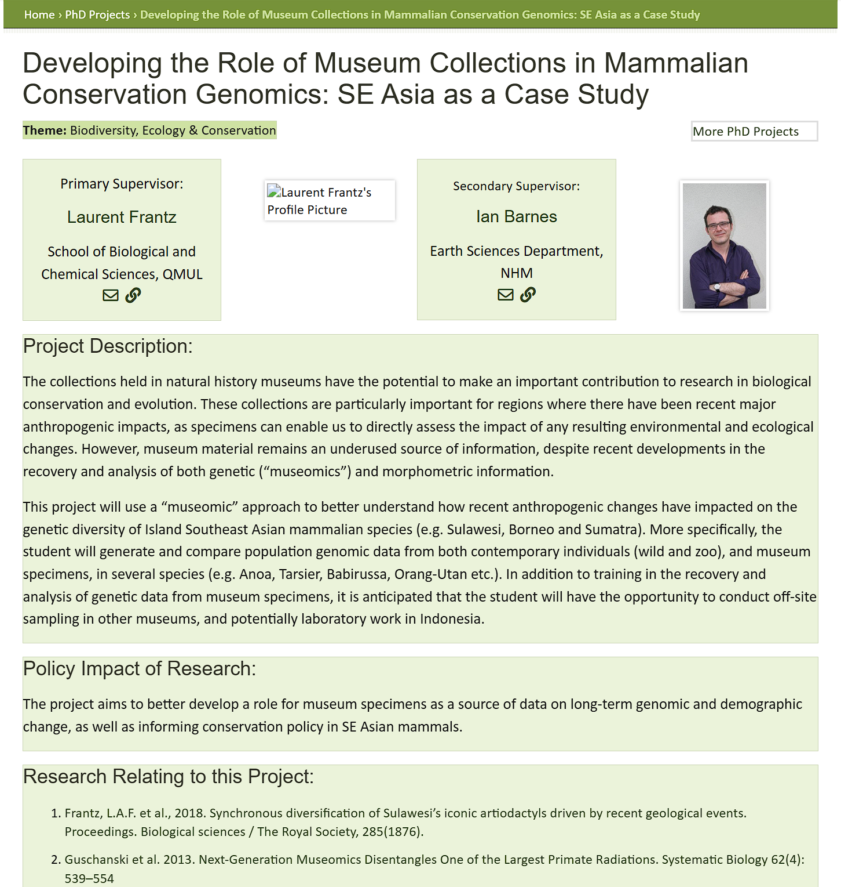
The nascent study of museomics
This may be adapted to work well as an RBG Kew collaboration like these: PeerJ Award Winners at the Natural History Museum Student Conference | PeerJ Blog

Slide 7
Lend a hand to Kili-SES?
It’s still a massive ongoing project
Very impactful and relevant

Slide 8
Pitch me your proposals as well!
Enthusiasm is infectious
If there’s a research gap you’re excited about, then I could be as well
It has the benefit of maintaining our current research environment and structure

